Slide 1





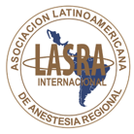







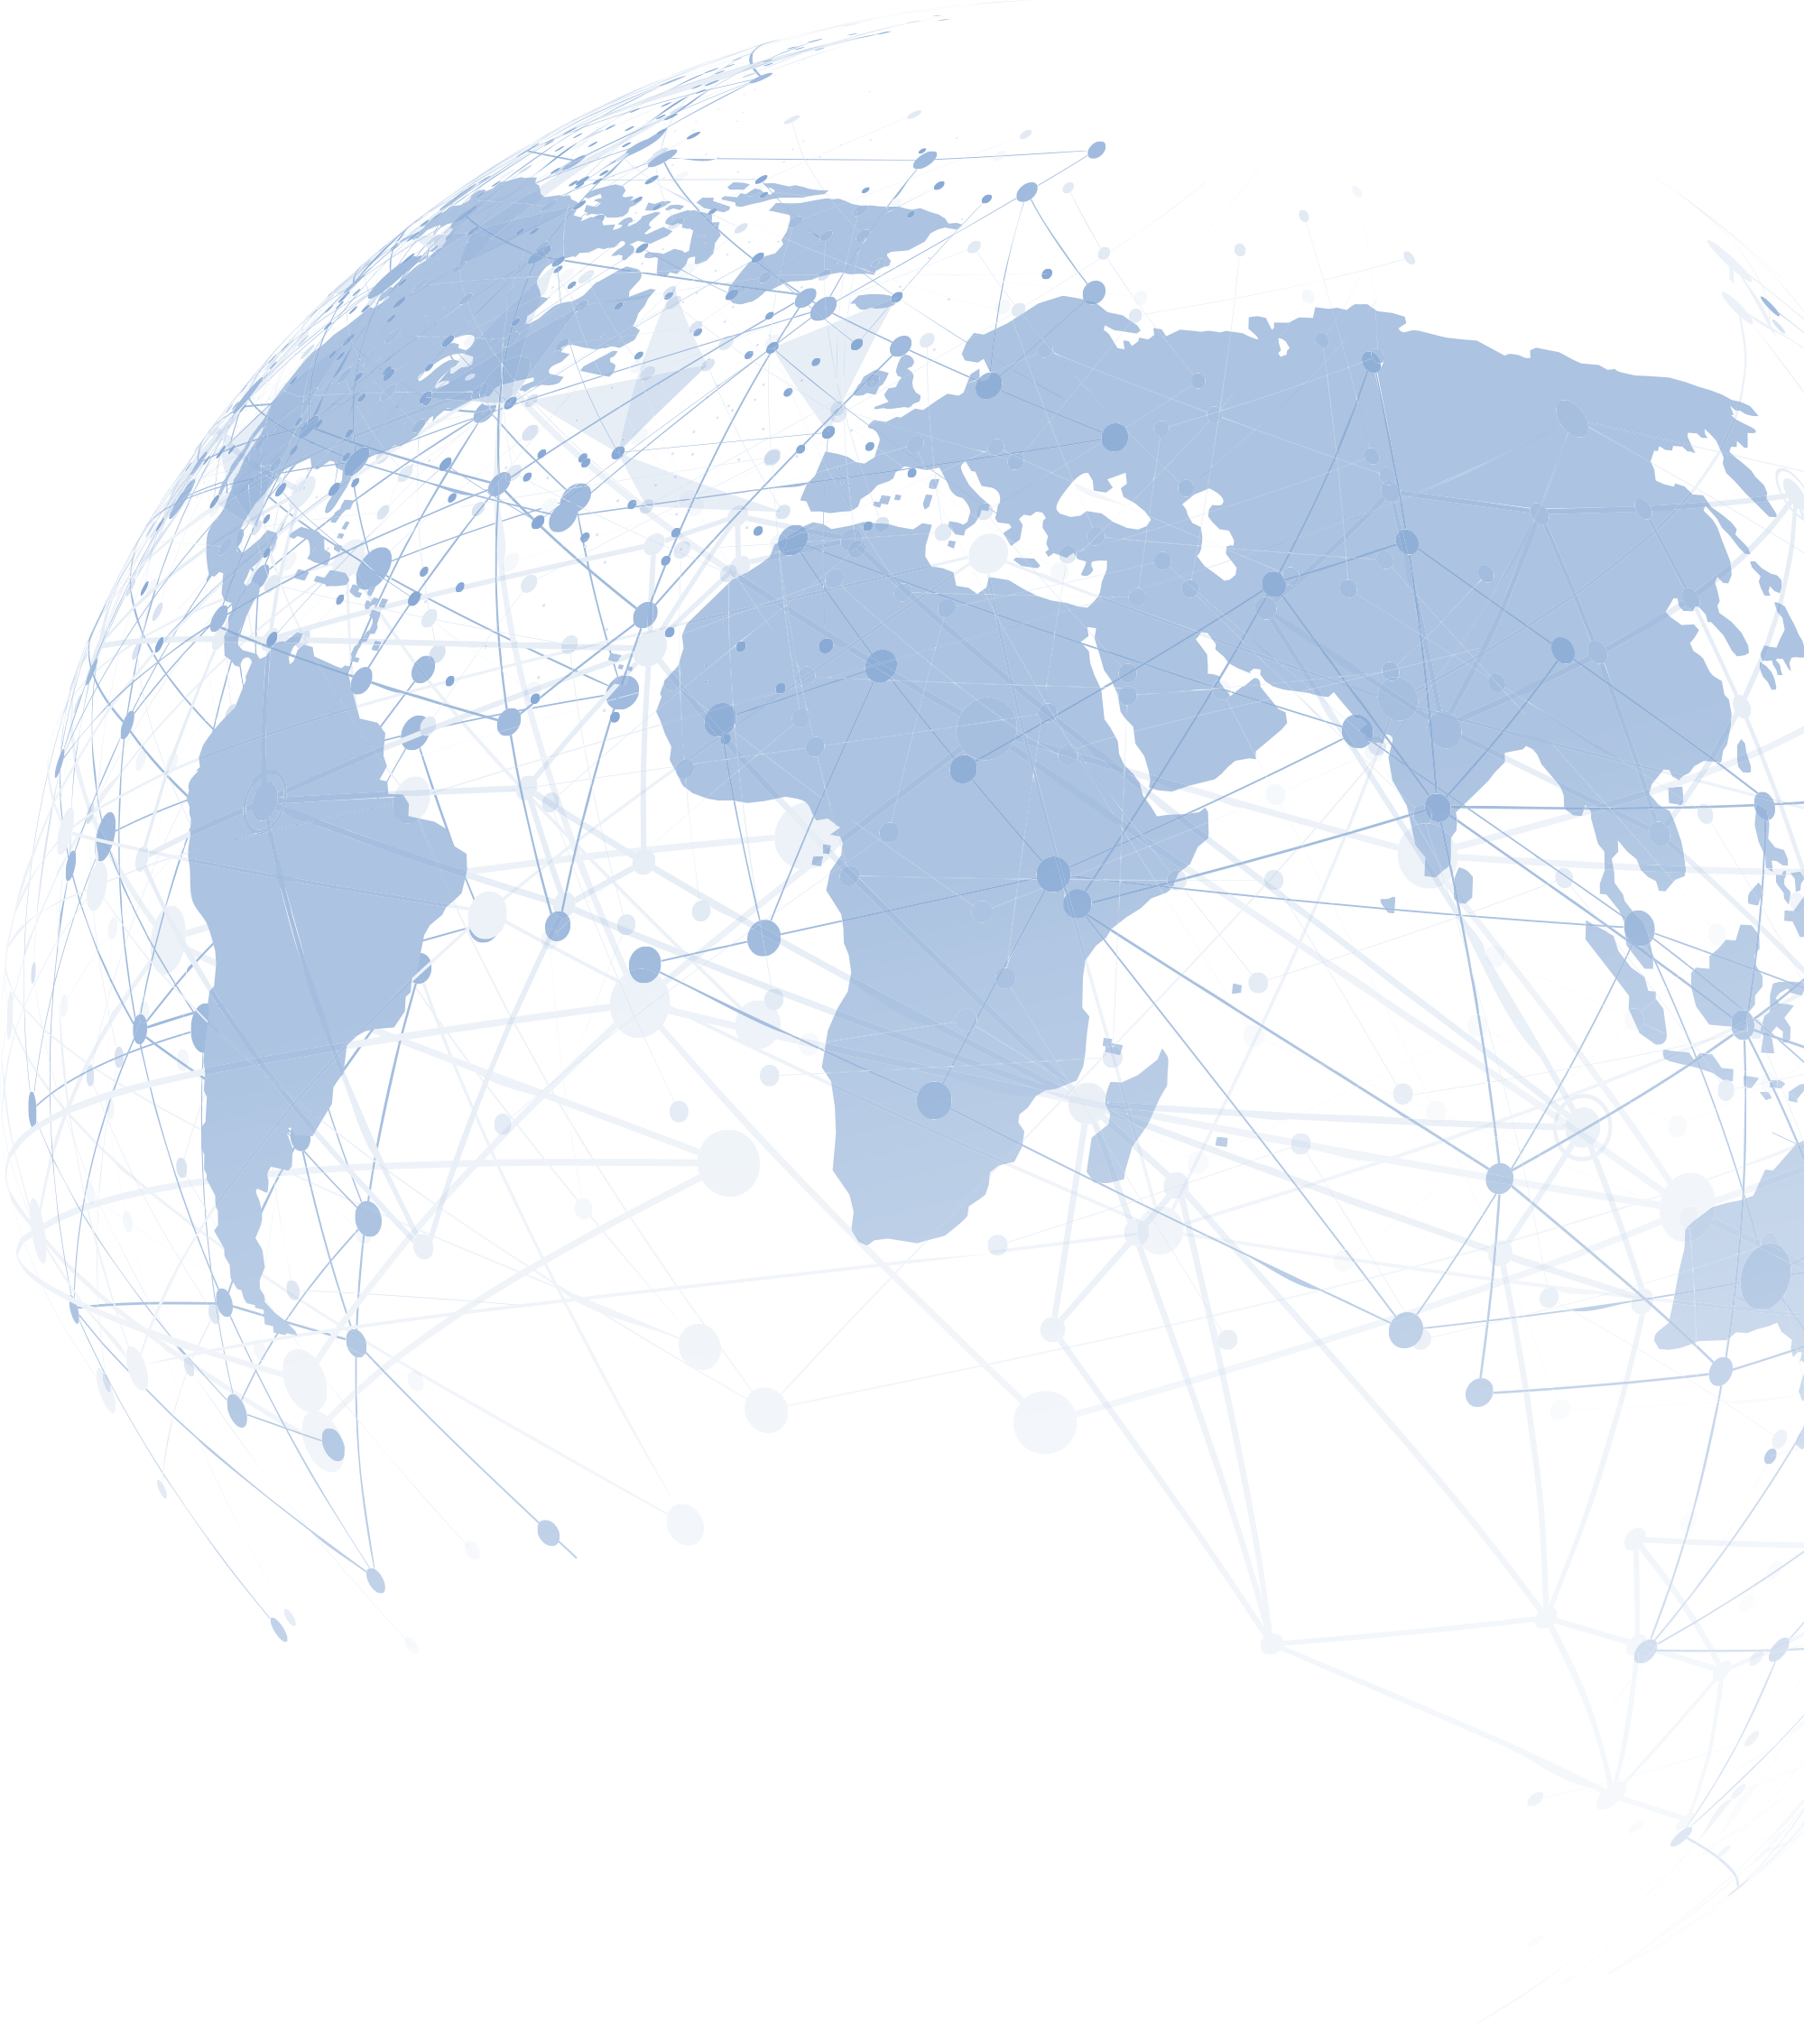




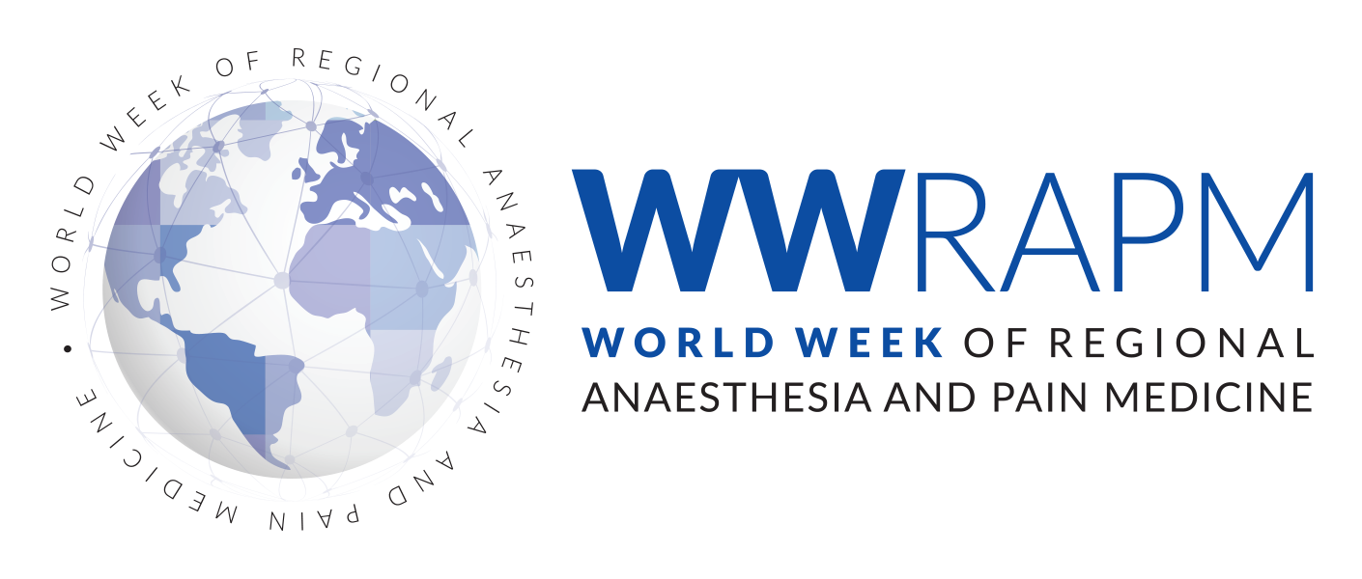




Simultaneous events across all continents!
More than 200 Cities in 80 Countries
are Joining Hands for a Pain Free Future Worldwide!
WORLD WEEK
OF REGIONAL ANAESTHESIA & PAIN MEDICINE
Equity, Access, Relief
24-31 January 2026
Your Local Face-to-Face Meeting
There must be one city around you!
Webpage: esraeurope.org
Contact us via email

