Slide 1













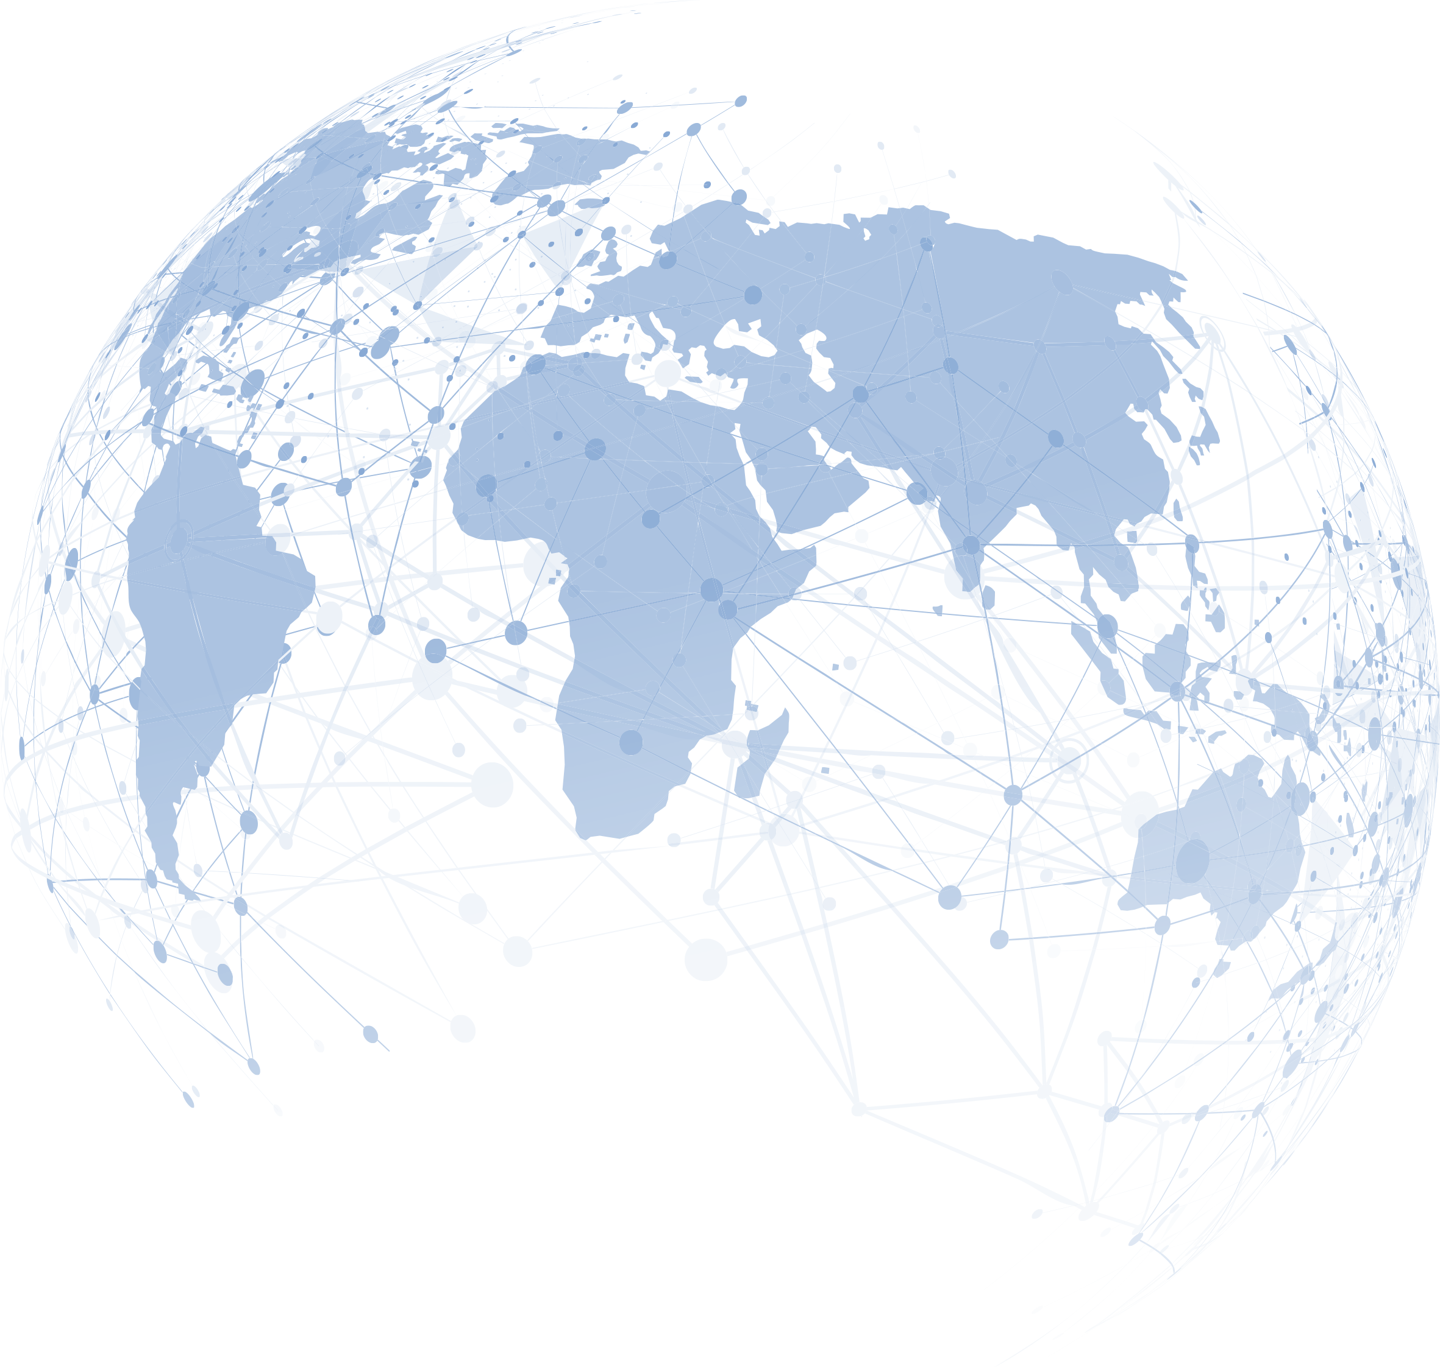










Simultaneous events across all continents!
More than 200 Cities in 80 Countries are Joining Hands for a Pain Free Future Worldwide!
WORLD DAY
OF REGIONAL ANAESTHESIA & PAIN MEDICINE
Equity, Access, Relief
Saturday, 31 January 2026
Your Local Face-to-Face Meeting
There must be one city around you!
Webpage: esraeurope.org
Contact us via email

Slide 2
Joining Hands for a Pain Free Future Worldwide
WORLD DAY OF REGIONAL ANAESTHESIA & PAIN MEDICINE
3rd Edition
Equity, Access, Relief
WELCOME MESSAGE
Dear Colleagues, Dear Friends
Welcome to the World Day of Regional Anaesthesia and Pain Medicine – 3rd Edition.
Our 2026 theme is practical and straightforward: Equity, Access, Relief - through Regional Anaesthesia.
Regional anaesthesia and Pain Medicine represent a global community. Clinicians from every continent have adopted these practices to enhance surgical safety, promote faster recovery, and ensure genuine patient comfort. In recent years, we have witnessed significant growth in this field, including the establishment of more training hubs, increased availability of ultrasound technology, improved safety protocols, and the development of clear pathways that make nerve blocks a routine part of patient care rather than an exception. Now is the time to capitalize on this momentum and secure these advancements for the future.
This year, our emphasis is on delivering neuraxial and peripheral techniques safely and reliably wherever care is given - from theatres and day-surgery centres to emergency departments, trauma services, maternity units and rural clinics.
Our 2026 priorities
Equity: the benefits of Regional anaesthesia and Pain Medicine should not depend on geography, language, or resources.
Access: practical training, supervision and essential kit—from ultrasound to robust landmark techniques—available in every setting.
Relief: timely, procedure-specific blocks that restore comfort, dignity and function.
Together with AFSRA, ASRA Pain Medicine, AOSRA Pain Medicine, LASRA, and national societies worldwide, we will focus on action:
Share and scale what works: open, multilingual teaching resources; simple, safe block pathways; checklists that travel.
Build capacity: mentorship, twinning and hands-on workshops that create local trainers and sustainable services.
Measure what matters: consistent data on access and outcomes so we can learn, improve and advocate effectively.
Support low-resource contexts: adaptable toolkits, essential medicines advocacy, and context-appropriate solutions—not one-size-fits-all.
Strengthen teams: interprofessional training and human factors that make Regional anaesthesia and Pain Medicine reliable in the busy clinical environment, not just in demonstrations.
Think long term: embed Regional anaesthesia and Pain Medicine within perioperative pathways, quality improvement, and environmentally responsible care.
How you can help
Host a hub. Teach a block. Translate a resource. Mentor a team. Share the learning.
Let this third World Day be remembered for its reach and readiness: more first-time sites delivering blocks; more clinicians confident with core techniques; more patients receiving the right block, at the right time, every time.
Thank you for your energy, generosity and commitment.
Equity. Access. Relief. With Regional Anaesthesia and Pain Medicine at the heart.
On behalf of ESRA, our Sister Societies and organising partners
Eleni Moka (Greece)
ESRA President
Nuala Lucas (UK)
Chair of the Event
Organizing & Scientific Committee

Slide 3
Joining Hands for a Pain Free Future Worldwide
WORLD DAY OF REGIONAL ANAESTHESIA & PAIN MEDICINE
3rd Edition
Equity, Access, Relief
ORGANIZING & SCIENTIFIC COMMITTEE
ESRA
Chair
Nuala Lucas (UK)
Members
Denisa Anastase (Romania)
Eleni Koraki (Greece)
Aleksejs Mišcuks (Latvia)
Raffaele Russo (Italy)
Athmaja Thottungal (UK)
Trainees Representative
Fay Alevrogianni (Greece)
Sister Societies & Continents Leaders – Representatives
ASRA Pain Medicine: USA
Raj Gupta (Nashville, Tennessee, TN)
Rakesh Sondekoppam (Palo Alto, California, CA)
CAS RA SIG: Canada
Ahtsham Niazi (Toronto, Ontario) Vivian Ip (Calgary, Alberta)
LASRA: Latin America
Ana Eugenia Herrera (Costa Rica) Sidonia Suazo (Honduras)
AFSRA: Africa
Lionelle Tchokam (Cameroon)
Noreddine Bouarroudj (Algeria)
AOSRA Pain Medicine
Asia Justin Sangwook Ko (Republic of Korea) Besthadi Suknomo (Indonesia) Suwimon Tangwiwat (Thailand)
Oceania (Australia & New Zealand) Alwin Chuan (Sydney, Australia)

Slide 4
Joining Hands for a Pain Free Future Worldwide
WORLD DAY OF REGIONAL ANAESTHESIA & PAIN MEDICINE
3rd Edition
Equity, Access, Relief
ENDORSING SOCIETIES
INDUSTRY PARTNERS

Slide 5
Joining Hands for a Pain Free Future Worldwide
WORLD DAY OF REGIONAL ANAESTHESIA & PAIN MEDICINE
3rd Edition
Equity, Access, Relief
RESOURCES
Pre-Recorded Welcome Addresses
Nuala Lucas, Chair of the Activity
Eleni Moka, ESRA President
Ezzat Aziz, AFSRA President
Suwimon Tangwiwat, AOSRA Secretary General
Steven Cohen, ASRA President
Ana Schwartzmann, LASRA President
Pre-Recorded Supportive Statements
Dr Miles Day, WIP President
Dr Jan van Zundert, WIP President Elect
Luis Garcia-Larrea, EFIC President
Dr Andre Ilbawi Technical Officer / Lead for Cancer Control (and palliative care), Department of Universal Health Coverage, World Health Organization (WHO) Headquarters, Geneva
Dr Gerry Eijkemans Director, Department of Social and Environmental Determinants for Health Equity, Pan American Health Organization
Dr Asmus Hammerich Director Non Communicable Diseases, WHO Eastern Mediterranean Office

Slide 6
Joining Hands for a Pain Free Future Worldwide
WORLD DAY OF REGIONAL ANAESTHESIA & PAIN MEDICINE
3rd Edition
Equity, Access, Relief
Pre-Recorded Lectures-Podcasts
My Top Regional Anaesthesia Papers of 2024-2025 Speaker: Steve Coppens Duration: 8 min
POCUS Papers you may have missed in 2025 Speaker: Rosie Hogg Duration: 15 min
Needles in a Haystack: Recent Papers Shaping our Understanding of Phantom Limb Pain Speaker: Pablo Rojas Zamora Duration: 13 min
Gastric POCUS Speaker: Peter Van De Putte Duration: 7 min
Keeping Kids Comfortable – RA in Paediatrics Speakers: Fatma Saricaoglou, Can Aksu Duration: 13 min
Updates in Obstetrics Anaesthesia Speaker: Nuala Lucas Duration: 14 min (short version) – 20min (long version)
Getting Nervous NAP8 Speaker: Alan MacFarlane Duration: 12 min
Sex and Gender differences in Pain and Pain Management Speaker: Athmaja Thottungal Duration: 7 min (short version) – 25min (long version)

Slide 7
Joining Hands for a Pain Free Future Worldwide
WORLD DAY OF REGIONAL ANAESTHESIA & PAIN MEDICINE
3rd Edition
Equity, Access, Relief
Pre-Recorded Lectures-Podcasts
Managing Post Caesarean Section Pain: Updated PROSPECT Recommendations Speaker: Marc Van de Velde Duration: 22 min
When RA fails: Rescue Blocks and Strategies for failed Regional Techniques Speaker: Romualdo Del Buono Duration: 10 min
Spinal Cord Stimulation: Myths, Evidence, and Uncomfortable Truths Speaker: Reda Tolba Host: Clara Lobo Duration: 16 min
The Use of AI in Regional Anesthesia: Exposure, Experience, Pros & Pons, Different Systems available Speakers: Amit Pawa, Jeff Gadsden Duration: 20 min
Anesthesia and Sleep Apnea dogmas: What we “believe” vs what we know (Society of Anesthesia and Sleep Medicine) Speakers: Philip A. Kurien, Mandeep Singh Host: Clara Lobo Duration: 20 min
Special entry… Pain as a Global Public Health Challenge
Speaker: Prof. Agis Tsouros Former Director of Policy and Governance for Health and Wellbeing at WHO Europe, International Adviser Health Policy, Equity and Diplomacy
Host: Eleni Moka
Duration: 20 min

Slide 8

Joining Hands for a Pain Free Future Worldwide
WORLD DAY OF REGIONAL ANAESTHESIA & PAIN MEDICINE
3rd Edition
Equity, Access, Relief
COMMON SCIENTIFIC PROGRAMME
ACROSS ALL CONTINENTS!!!
Plus, A Lot More…
Country–Wide Webinars
Live Streaming & YouTube Channel Connections
Dedicated App Available
Live Chats in Between Cities
Surveys Across Cities / Countries / Continents
World Games – Global Quiz Challenge For Trainees [Awards & Competitions]

Slide 9
13:00 to 17:00 UTC
13:00 to 17:00 UTC
Joining Hands for a Pain Free Future Worldwide
WORLD DAY OF REGIONAL ANAESTHESIA & PAIN MEDICINE
3rd Edition
Equity, Access, Relief
World Games – Global Quiz Challenge
… an activity for trainees
Sharp minds across the world, this one is for you!
This live, international quiz will bring together trainees from all regions of the world in a fast-paced competition designed to test knowledge, clinical reasoning, and decision-making skills.
Event Details
Date: Saturday, 31 January
Live Streaming Platform: ESRA YouTube Channel
Quiz Launch Times (hourly): 14:00 | 15:00 | 16:00 CET 13:00 | 14:00 | 15:00 UTC
(Participants may join ONLY one live session)
Quiz Format 25 MCQs testing your knowledge on Basic Sciences, Regional Anaesthesia Techniques, POCUS and Pain Medicine
Scores and rankings will be displayed live on the leaderboard throughout each session.
Awards The Top 3 winners will receive free registration for the ESRA Lisbon Congress!

Slide 10
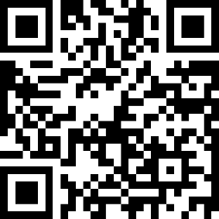
13:00 to 17:00 UTC
13:00 to 17:00 UTC
Joining Hands for a Pain Free Future Worldwide
WORLD DAY OF REGIONAL ANAESTHESIA & PAIN MEDICINE
3rd Edition
Equity, Access, Relief
World Games – Global Quiz Challenge
… an activity for trainees
How to Participate
Participation is free and open to all trainees attending the 3rd edition of WDRAPM.
The quiz will run via the Slido platform (web or app).
To join:
Scan the QR code below or click here
Important Participation Requirements
You must join using your full name and a valid email address Anonymous or incomplete registrations will not be eligible for ranking or prizes
The QR code and link will be active only on 31 January, during the scheduled quiz launch times listed above.
We encourage you to challenge yourself, represent your region, and take part in this global celebration of learning and collaboration!
We look forward to welcoming you to the ESRA World Games.
Scan the QR to participate!

Slide 11
SUGGESTED
SCIENTIFIC
PROGRAMME

Slide 12
Joining Hands for a Pain Free Future Worldwide
WORLD DAY OF REGIONAL ANAESTHESIA & PAIN MEDICINE
3rd Edition
Equity, Access, Relief
08:30-09:00 | VENUE – ARRIVALS – REGISTRATIONS
09:00-09:30 | WELCOME MESSAGES & ADDRESSINGS
 | City Representative/ City Liaison Person (in person) for opening the event Country Representative (either in person or via zoom) Nuala Lucas – Chair of Event (via live streaming / recording stand by) Eleni Moka – ESRA President (via live streaming / recording stand by) Sister Societies Presidents (either recordings or via live streaming) Other Addressings (can be added as per each city needs)
09:30 - 11:00 | SESSION 1 – THE EVIDENCE CLUB
 | Chairperson (Local / To be decided)
09:30 – 10:00 | Top papers in RA from 2024–25 (Local Speaker to be decided)
10:00 – 10:30 | Top papers in Pain Medicine from 2024–25 (Local Speaker to be decided)
10:30 – 11:00 | Q&A – Discussion
11:00 – 11:30 | COFFEE BREAK
11:30 – 13:00 | SESSION 2 – The Power of Three: Innovation - Equity - Rescue
 | Chairperson (Local / To be decided)
11:30 – 11:50 | The Innovation Club: What’s new in drug delivery, catheters, pumps, adjuvants, AI decision support (Local Speaker to be decided)
11:50 – 12:10 | The Equity Club Access to RA & analgesia in LMICs, WHO essential medicines, and strategies for training without ultrasound (Local Speaker to be decided)
12:10 – 12:30 | The Rescue Club: When RA fails: troubleshooting blocks, managing LAST, escalation to systemic analgesia/opioids (Local Speaker to be decided)
12:30 – 13:00 | Q&A – Discussion
13:00 – 13:45 | LUNCH BREAK

Slide 13
Joining Hands for a Pain Free Future Worldwide
WORLD DAY OF REGIONAL ANAESTHESIA & PAIN MEDICINE
3rd Edition
Equity, Access, Relief
13:45 – 16:00 | SESSION 3 – Beyond the Block: Regional Anaesthesia across the patient journey
 | Chairperson (Local / To be decided)
13:45 – 14:05 | Beyond the OR: RA in trauma, emergency, humanitarian settings (Local Speaker to be decided)
14:05 – 14:25 | Transitional pain services: preventing chronic post-surgical pain (Local Speaker to be decided)
14:25 – 15:00 | What’s new in obstetrics? (Local Speaker to be decided)
15:00 – 15:25 | Keeping Kids Comfortable – RA in Paediatrics (Local Speaker to be decided)
15:25 – 16:00 | Q&A – Discussion
16:00 – 16:30 | COFFEE BREAK
16:30 – 18:30 | SESSION 4 – HANDS ON CLINICAL WORKSHOPS
 | For example: 4 stations, 30 min per station, 2h total duration (Topics & Demonstrators to be decided at the local level)
18:30 – 19:00 | END OF E–DAY: QUESTIONS – COMMENTS – DISCUSSION

Slide 14
Joining Hands for a Pain Free Future Worldwide
WORLD DAY OF REGIONAL ANAESTHESIA & PAIN MEDICINE
3rd Edition
Equity, Access, Relief
Suggested discussion points
Top Papers in RA (2024-25)
Methodology check – Were these trials large, multicentre, and pragmatic enough to change practice, or are they single-centre signals?
Block choice – Do the findings favour new fascial plane blocks over classics (e.g., paravertebral, plexus blocks), and should we adopt them?
Opioid-sparing evidence – How convincing is the data that RA reduces opioid use and improves recovery beyond the first 24 hours?
Implementation – What barriers (training, ultrasound access, equipment costs) might prevent us from translating this evidence into everyday care?
Equity & sustainability – Do these papers consider LMIC contexts or environmental impact, and should that influence how we judge their importance
Top Papers in Pain Medicine (2024–25)
New drugs & adjuvants – Which pharmacological advances (e.g., novel neuropathic agents, ketamine/esketamine, biologics) look truly practice-changing?
Interventional techniques – Are new RCTs on procedures (e.g., nerve ablation, neuromodulation, targeted drug delivery) robust enough to support wider uptake?
Chronic pain models – How do the studies address the biopsychosocial model — do they balance physical, psychological, and social outcomes?
Opioid stewardship – What’s new in opioid-sparing or opioid-optimising strategies for chronic pain, and how do these align with WHO’s agenda for equitable access?
Patient-centred outcomes – Did the studies report outcomes that matter to patients (function, QoL, return to work), or mainly surrogate measures (pain scores, drug use)?

Slide 15
Joining Hands for a Pain Free Future Worldwide
WORLD DAY OF REGIONAL ANAESTHESIA & PAIN MEDICINE
3rd Edition
Equity, Access, Relief
SIMULTANEOUS EVENTS
ACROSS ALL CONTINENTS!!!
AFRICA …
ASIA ...
AUSTRALIA & NEW ZEALAND ...
CANADA
EUROPE ...
LATIN AMERICA ...
MIDDLE EAST & GULF ...
UNITED STATES OF AMERICA

Slide 16
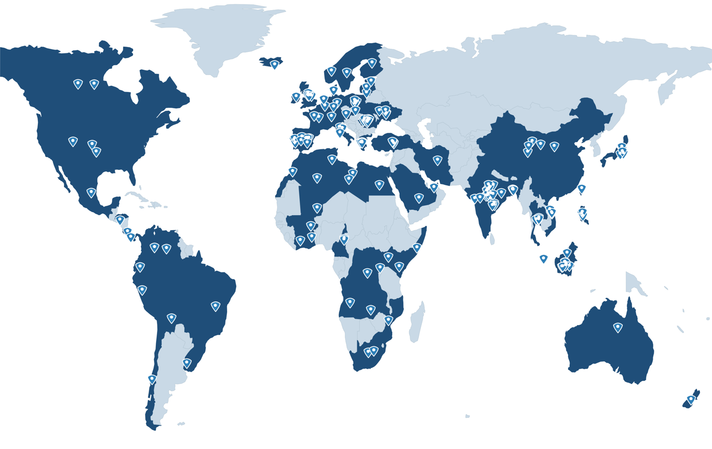
Joining Hands for a Pain Free Future Worldwide
WORLD DAY OF REGIONAL ANAESTHESIA & PAIN MEDICINE
3rd Edition
Equity, Access, Relief
SIMULTANEOUS EVENTS
ACROSS ALL CONTINENTS!!!
Countries: 78
Cities: 194

Slide 17
Joining Hands for a Pain Free Future Worldwide
WORLD DAY OF REGIONAL ANAESTHESIA & PAIN MEDICINE
3rd Edition
Equity, Access, Relief
Your Local Face-to-Face Meeting!
PARTICIPATING COUNTRIES & CITIES
EUROPE
AUSTRIA
Steyr
BALTIC STATES
Kaunas (Lithuania)
BELGIUM
Brussels
FRANCE
Paris, La Reunion
GERMANY
Stuttgart, Marburg
GREECE
Athens, Thessaloniki, Larissa
IRELAND
an Ireland–Wide Webinar
ITALY
Modena, Rome, San Giovanni Rotondo
MALTA
Valletta
POLAND Katowice, Poznan, Szczecin, Warsaw
PORTUGAL
Funchal, Ponta Delgada, Porto
ROMANIA
Bucharest, Cluj–Napoca, Constanta, Craiova, Iasi, Oradea, Targu–Mures, Timisoara
SCANDINAVIA – NORDIC COUNTRIES
for a Nordic Countries–Wide Webinar
Denmark, Finland, Iceland, Norway, Sweden
SLOVAKIA
Banska Bystrica
SPAIN
Alicante, Barcelona, La Coruna, Madrid, Marbella San Sebastian, Sevilla, Valladolid
SWITZERLAND
Bern
TURKEY
Ankara, Istanbul, Manisa
NETHERLANDS Sint-Michielsgestel
UNITED KINGDOM
Canterbury, Frimley Park, Hull, Newcastle Upon Tyne, Nottingham UKRAINE Ivano–Frankivsk, Kyiv, Rivne, Vinnytsa

Slide 18
Joining Hands for a Pain Free Future Worldwide
WORLD DAY OF REGIONAL ANAESTHESIA & PAIN MEDICINE
3rd Edition
Equity, Access, Relief
PARTICIPATING COUNTRIES & CITIES
AFRICA
ALGERIA
Algiers
ANGOLA
Luanda
BURKINA FASO
Bobo Dioulasso
Ouagadougou
CAMEROON
Garoua, Douala, Yaounde
DEMOCRATIC REPUBLIC OF CONGO (DRC)
Bukavu, Kinshasa
EGYPT
Benha Cairo
GHANA
Cape Coast, Accra
IVORY COAST
Abidjan
KENYA
Nairobi
LIBERIA
Monrovia
LIBYA
Tripoli, Benghazi
MALI
Région du Nord (GAO)
MOROCCO Rabat, Casablanca
MOZAMBIQUE
Maputo
NAMIBIA
Oshakati, Windhoek
RWANDA
Kigali
SENEGAL
Dakar
SOMALIA
Mogadishu
SOMALILAND
Hargeisa
SOUTH AFRICA
George
Johannesburg
TUNISIA
Tunis
UGANDA
Kabale
ZAMBIA
Lusaca

Slide 19
Joining Hands for a Pain Free Future Worldwide
WORLD DAY OF REGIONAL ANAESTHESIA & PAIN MEDICINE
3rd Edition
Equity, Access, Relief
Your Local Face-to-Face Meeting!
PARTICIPATING COUNTRIES & CITIES
ASIA & MIDDLE EAST–GULF
BANGLADESH
Chattogram Dhaka North Dhaka South Sylhet
CHINA Beijing Guizhou Province Hebei Province Sichuan Province Zhejiang Province
INDIA Bhubnaeswar Coimbatore Delhi Faridabad Gorakhpur Hyderabad Jaipur Kolkata Mangaluru Mumbai Nagpur New Delhi Patna Pune Rajkot Varanasi
INDONESIA
Bali Banda Aceh Bandar Lampung Bandung Denpasar Jakarta Jambi Makassar Malang Manado Medan Padang Palembang Pekanbaru Purwokerto Semarang Surabaya Surakarta Yogyakarta
IRAN Tehran
JAPAN Kamogawa Kobe Kumamoto Okazaki
KINGDOM OF SAUDI ARABIA Riyadh
MALAYSIA Kuala Lumpur
PHILIPPINES Bohol Davao Quezon City
SINGAPORE Singapore
TAIWAN Taichung
THAILAND Bangkok Chiang Mai Khon Kaen Songkhla
UNITED ARAB EMIRATES Abu Dhabi Dubai
VIETNAM Buon Ma Thuot Thai Nguyen

Slide 20
Joining Hands for a Pain Free Future Worldwide
WORLD DAY OF REGIONAL ANAESTHESIA & PAIN MEDICINE
3rd Edition
Equity, Access, Relief
PARTICIPATING COUNTRIES & CITIES
NORTH AMERICA
UNITED STATES OF AMERICA (USA)
Chapel Hill, North Carolina, NC
and ... US–Wide Webinar!!!
CANADA
For a Canada–Wide Webinar!!!
With Participating Experts from 3 cities:
Calgary, Toronto, Vancouver
Across 3 provinces:
Alberta, British Columbia, Ontario
For the In–Person Workshop
Banff, Alberta
LATIN AMERICA
OCEANIA
BRAZIL
Sao Luis
BOLIVIA
La Paz
CHILE
Santiago
COLOMBIA
Bogota
COSTA RICA
San Jose
HONDURAS
Lima
MEXICO
Mexico city
PANAMA
Panama City
PERU
Lima
URUGUAY
Montevideo
VENEZUELA
Caracas
AUSTRALIA
Adelaide
Brisbane
Melbourne
Perth
Sydney
NEW ZEALAND
Auckland

Slide 21
Joining Hands for a Pain Free Future Worldwide
WORLD DAY OF REGIONAL ANAESTHESIA & PAIN MEDICINE
3rd Edition
Equity, Access, Relief
COUNTRIES & CITIES LEADERS – REPRESENTATIVES
EUROPE
Leader: Sebastien Bloc (France)
AUSTRIA: Marcus Neumüller
• Steyr: Marcus Neumüller
BALTIC STATES: Irina Evansa
• Kaunas (Lithuania): Arunas Gelmanas
BELGIUM: Matthias Desmet
• Brussels: Matthias Desmet
FRANCE: Sebastien Bloc
• Paris: Sébastien Bloc, Julien Raft
GERMANY: Rebecca Heinen
• Marburg: Rebecca Heinen
• Stuttgart: Rebecca Heinen
GREECE: Evmorfia Stavropoulou
• Athens: Kassiani Theodoraki, Krystallia Vitoula
• Larissa: Eleni Arnaoutoglou, Metaxia Bareka
• Thessaloniki: Eleni Argyriadou, Eleni Koraki
IRELAND: Conor Skerritt
• Letterkenny: Conor Skerritt
ITALY: Romualdo Del Buono
• Modena: Romualdo Del Buono
• Rome: Fabrizio Fattorini
• San Giovanni Rotondo: Raffaele Russo
MALTA: Petramay Cortis
• Valletta: Petramay Cortis
POLAND: Wojciech Gola
• Katowice: Szymon Bialka
• Poznan: Tomasz Reysner, Małgorzata Reysner
• Szczecin: Agata Andrzejewska
• Warsaw: Marek Janiak
PORTUGAL: Lara Ribeiro
• Funchal: Lara Ribeiro
• Ponta Delgada: Lara Ribeiro
• Porto: Lara Ribeiro
ROMANIA: Liliana Mirea
• Bucharest: Liliana Mirea
• Cluj-Napoca: Dan Sebastian Dîrzu
• Constanta: Stelian Mociu
• Craiova: Marius Novac
• Iasi: Irina Ristescu
• Oradea: Mihai Botea
• Targu-Mureș: Marius Petrisor
• Timișoara: Marius Păpurică
NORDIC COUNTRIES: Axel Sauter
• Wide Webinar

Slide 22
Joining Hands for a Pain Free Future Worldwide
WORLD DAY OF REGIONAL ANAESTHESIA & PAIN MEDICINE
3rd Edition
Equity, Access, Relief
COUNTRIES & CITIES LEADERS – REPRESENTATIVES
EUROPE
Leader: Sebastien Bloc (France)
SLOVAKIA: Michal Venglarcik
• Banská Bystrica: Michal Venglarcik
SPAIN: Vicente Roques
• Alicante
• Barcelona: Carlos Morros
• La Coruna: Pablo Casas
• Madrid: Alejandro Ortega
• Marbella: Luis Valdes
• San Sebastian: Carlos Yarnoz
• Sevilla: Jose Manuel Lopez – Millan
• Valladolid: Maite Fernandez
SWITZERLAND: Andrea Saporito
• Bern: Friedrich Lersch
THE NETHERLANDS: Kavita Houthoff Khemlani
• Sint-Michielsgestel: Kavita Houthoff Khemlani
TURKEY: Ismet Topcu
• Ankara: Derya Ozkan
• Istanbul: Can Aksu
• Manisa: İsmet Topçu
UNITED KINGDOM: Nat Haslam
• Canterbury: Athmaja Thottungal
• Frimley Park: Madan Narayanan
• Hull: Balaji Packianathaswamy, Jakub Kazda
• Newcastle Upon Tyne: Nat Haslam, Kiran Koneti
• Nottingham: Amr Hassan
UKRAINE: Maskym Barsa
• Ivano-Frankivsk: Yaroslav Semkovych
• Kyiv: Kateryna Bielka
• Rivne: Maskym Barsa
• Vinnytsia: Dmytro Dmytriiev

Slide 23
Benha
Benha
Joining Hands for a Pain Free Future Worldwide
WORLD DAY OF REGIONAL ANAESTHESIA & PAIN MEDICINE
3rd Edition
Equity, Access, Relief
COUNTRIES & CITIES LEADERS – REPRESENTATIVES
AFRICA
Leaders: Lionelle Tchokam (Cameroon) & Noreddine Bouarroudj (Algeria)
ALGERIA: Bouarroudj Noreddine
• Algiers: Bouarroudj Noreddine
ANGOLA: Silvina Pereira
• Luanda: Silvina Pereira
BURKINA FASO: Aida Zongo
• Ouagadougou: Aida Zongo
CAMEROON: Lionelle Tchokam
• Douala: Nana Manuella, Nga Nomo Serge
• Yaounde: Nana Manuella, Nga Nomo Serge
DEMOCRATIC REPUBLIC OF THE CONGO: William Baracka
• Bukavu: William Baracka
EGYPT: Ezzat Aziz, Mohamed Mostafa
• Cairo: Ahmed Zaghloul • Benha: Zeyad Elbagoury
GHANA: Ekor Oluwayemisi
• Accra: Ekor Oluwayemisi
IVORY COAST: Kone Kadidja
• Abidjan: Kone Kadidja
KENYA: Sonia Lalla
• Nairobi: Sonia Lalla
LIBYA: Mohamed Tantoush
• Tripoli: Mohamed Tantoush
MALI: Soumana Coulibaly
• Region du Nord (GAO): Soumana Coulibaly
MOROCCO: Afak Nsiri
• Casablanca: Afak Nsiri • Rabat: Afak Nsiri
MOZAMBIQUE: Hamilton Arnaldo
• Maputo: Hamilton Arnaldo
NAMIBIA: Kavezembua Kavari
• Oshakati: tbc
• Windhoek: tbc
RWANDA: Nyandwi Jean Damascene
• Kigali: Nyandwi Jean Damascene
SOMALIA: Abdullahi Said Hashi
• Mogadishu: Abdullahi Said Hashi
SOUTH AFRICA: Francois Retief
• George: Nondwe Ngoqo, André Theron, Maria Fourtounas
• Johannesburg: Nondwe Ngoqo, André Theron, Maria Fourtounas
TUNISIA: Maissa Daiki
• Tunis: Maissa Daiki
UGANDA: Isabella Epiu
• Kabale: Isabella Epiu
ZAMBIA: Maria Kansenga
• Lusaca: Maria Kansenga

Slide 24
Joining Hands for a Pain Free Future Worldwide
WORLD DAY OF REGIONAL ANAESTHESIA & PAIN MEDICINE
3rd Edition
Equity, Access, Relief
COUNTRIES & CITIES LEADERS – REPRESENTATIVES
ASIA & MIDDLE EAST-GULF
Leaders: Besthadi Suknomo (Indonesia), Suwimon Tangwiwat (Thailand) & Justin Sangwook Ko (Republic of Korea)
BANGLADESH: Lutful Aziz
• Chattogram: KM Baki Billah, Mohiuddin Majed Chowdhury
• Dhaka North: Lutful Aziz
• Dhaka South: AKM Akhtaruzzaman
• Sylhet: Reazul Haque
CHINA: Yun Wang
• Beijing: Yun Wang
• Guizhou Province: Zhou Jing
• Hebei Province: Li Lin
• Sichuan Province: Zhao Daqiang
• Zhejiang Province: Zhou Hongmei
KINGDOM OF SAUDI ARABIA: Ayman Mustafa
• Riyadh: Ayman Mustafa
UNITED ARAB EMIRATES: Clara Lobo, Dikshitha Chetty
• Abu Dhabi: Saurabh Suri, Mhamad Hashimi, Yara Al Jalbout
• Dubai: Dikshitha Kshirasagar Chetty
INDIA: Ritesh Roy
• Bhubnaeswar: Ritesh Roy, Gaurav Agarwal, Neha Singh
• Coimbatore: Vipin Kumar Goel
INDIA: Ritesh Roy
• Faridabad: Divesh Arora
• Gorakhpur: Santosh Kumar Sharma
• Hyderabad: Sunil T Pandya
• Jaipur: Vandana Mangal
• Kochi: Sachin George • Kolkata: Ravindra Wankhede
• Mangaluru: Shilpa Bhat
• Mumbai: Vrushali Ponde
• Nagpur: Bhuvaneswari Balasubramanian
• New Delhi: Anju Gupta, Sandeep Diwan • Patna: Chandni Sinha, Shruti Shrey
• Pune: Pramod S Palhade
• Rajkot: Hetal Vadera
• Varanasi: Amrita Rath • Vijayawada: Sridevi Valluri
INDONESIA: Besthadi Suknomo
• Bali: IGN Mahaalit Aribawa
• Banda Aceh: Rahmi
• Bandar Lampung: Hario Tri Hen
• Bandung: M. Andy Prihartono
• Denpasar: Gusti Ngurah Mahaalit Aribawa
• Jakarta: Rizky Ramadhana

Slide 25
Joining Hands for a Pain Free Future Worldwide
WORLD DAY OF REGIONAL ANAESTHESIA & PAIN MEDICINE
3rd Edition
Equity, Access, Relief
COUNTRIES & CITIES LEADERS – REPRESENTATIVES
ASIA & MIDDLE EAST-GULF
Leaders: Besthadi Suknomo (Indonesia), Suwimon Tangwiwat (Thailand) & Justin Sangwook Ko (Republic of Korea)
INDONESIA: Besthadi Suknomo
• Jambi: Andi Hasyim
• Makassar: Nur Surya Wirawan
• Malang: Ristiawan Muji Laksono
• Manado: Barry Imanuel Kambey
• Medan: Tasrif Hamdi
• Padang: Ruth Evlin Margaretha
• Palembang: Aidyl Fitrisyah
• Pekanbaru: T. Arfi Sulaiman
• Purwokerto: Aunun Rofik
• Semarang: Mochamat
• Surabaya: Dedi Susila
• Surakarta: Bara Adithya
• Yogyakarta: Farhan Ali Rahman
IRAN: Poupak Rahimzadeh
• Tehran: Poupak Rahimzadeh
JAPAN: Shinichi Sakura
• Yokohama: Itaru Watanabe • Kamogawa: Takeshi Murouchi
• Kobe: Kentaro Kida
• Kumamoto: Naoki Miyazaki
• Okazaki: Norihiro Sakai
MALAYSIA: Iskandar Khalid
• Kuala Lumpur: Ng Sook Hoon
PHILIPPINES: Dahlia Arancel, Lily Roxas-Jingco
• Bohol: Lily Roxas-Jingco
• Davao: Dahlia Salanio-Arancel
• Manila: Penafrancia Cano
REPUBLIC OF KOREA: Ashokka Balakrishnan
• Seoul: Won Uk Koh
SINGAPORE: Ashokka Balakrishnan
• Singapore: Ashokka Balakrishnan
TAIWAN: Jui-An Lin
• Taichung: Farn-Wen Tseng
THAILAND: Suwimon Tangwiwat
• Bangkok: Suwimon Tangwiwat
• Chiang Mai: Prangmalee Leurcharusmee
• Khon Kaen: Aumjit Wittayapairoj
• Songkhla: Jatuporn Pakpirom
VIETNAM: Minh Nguyen Van
• Buon Ma Thuot: Dang The Thanh
• Hanoi: Vu Xuan Quang • Ho Chi Minh: Pham Hoang Manh
• Thai Nguyen: Lan Pham
OCEANIA
Leader: Alwin Chuan (Sydney, Australia)
AUSTRALIA & NEW ZEALAND: Alwin Chuan
Wide Webinar (Adelaide, Brisbane, Melbourne, Perth, Sydney, Auckland): Alwin Chuan

Slide 26
Joining Hands for a Pain Free Future Worldwide
WORLD DAY OF REGIONAL ANAESTHESIA & PAIN MEDICINE
3rd Edition
Equity, Access, Relief
COUNTRIES & CITIES LEADERS – REPRESENTATIVES
NORTH AMERICA
Leaders: Raj Gupta - Rakesh Sondekoppam (USA) & Vivian Ip - Ahtsham Niazi (Canada)
UNITED STATES OF AMERICA (USA): Raj Gupta & Rakesh Sondekoppam
Chapel Hill, North Carolina: Stuart Grant
Nashville, Tennessee: Rajnish Gupta
Palo Alto, California: Rakesh Sondekoppam
CANADA: Vivian Ip & Ahtsham Niazi
Calgary, Alberta: Vivian Ip, Joanna Fifen
Toronto, Ontario: Ahtsham Niazi
Vancouver, British Columbia: Tim Jen, Peter Rose
LATIN AMERICA
Leaders: Ana Eugenia Herrera (Costa Rica) & Sidonia Suazo (Honduras)
BRAZIL: Joao Batista Santos
• Sao Luis: Joao Batista Santos
ECUADOR: Diana Chango
• Kito: Diana Chango
BOLIVIA: Jorge Miguel Arratia Calderón
• La Paz: Jorge Miguel Arratia Calderón
CHILE: Pablo Miranda Hiriart
• Santiago: Pablo Miranda Hiriart
COLOMBIA: Nora Marcela Mendoza, Nurys Hernández
• Bogota: Nora Marcela Mendoza, Nurys Hernández
COSTA RICA: Oscar Ledezma
• San Jose: Oscar Ledezma
HONDURAS: Sidonia Suazo Reyes, Guillermo Pineda
• Tegucigalpa: Sidonia Suazo Reyes, Guillermo Pineda
MEXICO: Arely Torres Maldonado
• Mexico City: Arely Torres Maldonado
PANAMA: Jonathan Batista, Stanley Wu Tai
• Panama City: Jonathan Batista, Stanley Wu Tai
PERU: Mabel Paz
• Lima: Mabel Paz
URUGUAY: Paola Alcarraz, Ana Schwartzman
• Montevideo: Paola Alcarraz
VENEZUELA: María Eugenia Seijas
• Caracas: María Eugenia Seijas

Slide 27














Joining Hands for a Pain Free Future Worldwide
WORLD DAY OF REGIONAL ANAESTHESIA & PAIN MEDICINE
3rd Edition
Equity, Access, Relief
Participating SoCieties & ORGANIZATIONS

Slide 28

























Joining Hands for a Pain Free Future Worldwide
WORLD DAY OF REGIONAL ANAESTHESIA & PAIN MEDICINE
3rd Edition
Equity, Access, Relief
Participating SoCieties & ORGANIZATIONS

Slide 29
Joining Hands for a Pain Free Future Worldwide
WORLD DAY OF REGIONAL ANAESTHESIA & PAIN MEDICINE
3rd Edition
Equity, Access, Relief
NOTES

Slide 30
Joining Hands for a Pain Free Future Worldwide
WORLD DAY OF REGIONAL ANAESTHESIA & PAIN MEDICINE
3rd Edition
Equity, Access, Relief
NOTES

