Slide 1

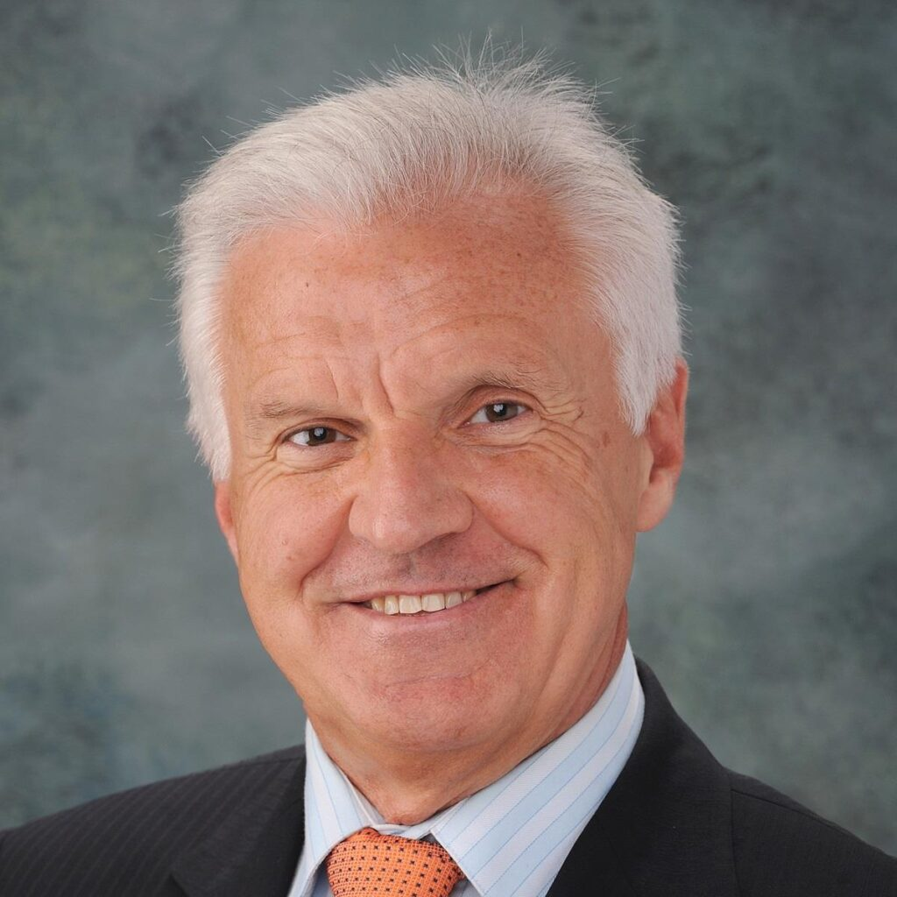
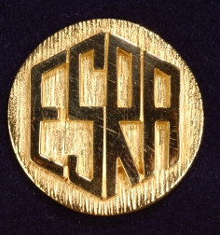
Professor André van Zundert
2025 Carl Koller Gold Medal Award

