Slide 1






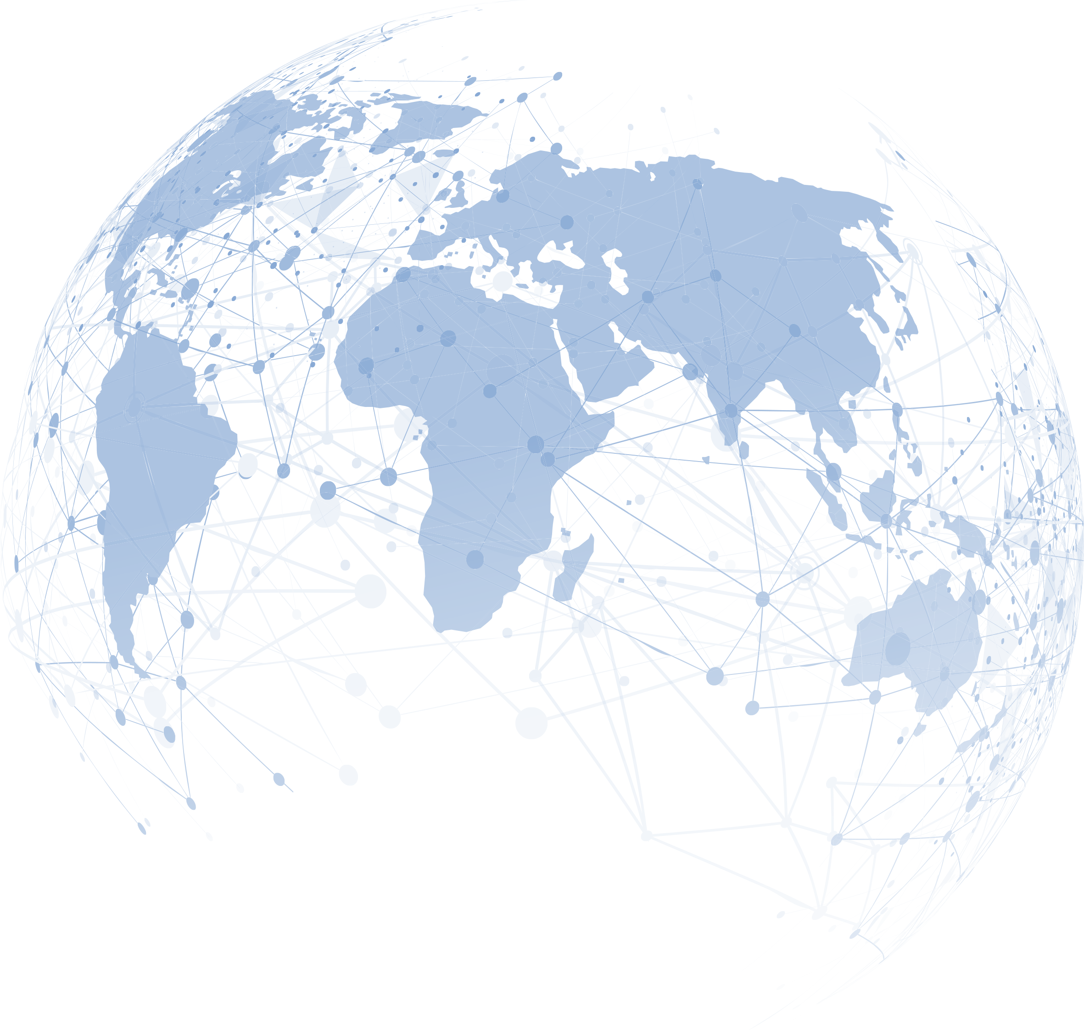




Joining Hands for
a Pain Free Future Worldwide
WORLD DAY
OF REGIONAL ANAESTHESIA & PAIN MEDICINE
3rd Edition
Equity, Access, Relief
Saturday, 31 January 2026
Your Local Face-to-Face Meeting
There must be one city around you!
ESRA Office: Rue de Chantepoulet 10, 1201 Geneva, Switzerland
Email: office@esraeurope.org
Info and Registrations
esraeurope.org

Slide 2
Joining Hands for a Pain Free Future Worldwide
WORLD DAY OF REGIONAL ANAESTHESIA & PAIN MEDICINE
3rd Edition
Equity, Access, Relief
WELCOME MESSAGE
Dear Colleagues, Dear Friends
Welcome to the World Day of Regional Anaesthesia and Pain Medicine – 3rd Edition.
Our 2026 theme is practical and straightforward: Equity, Access, Relief - through Regional Anaesthesia.
Regional anaesthesia and Pain Medicine represent a global community. Clinicians from every continent have adopted these practices to enhance surgical safety, promote faster recovery, and ensure genuine patient comfort. In recent years, we have witnessed significant growth in this field, including the establishment of more training hubs, increased availability of ultrasound technology, improved safety protocols, and the development of clear pathways that make nerve blocks a routine part of patient care rather than an exception. Now is the time to capitalize on this momentum and secure these advancements for the future.
This year, our emphasis is on delivering neuraxial and peripheral techniques safely and reliably wherever care is given - from theatres and day-surgery centres to emergency departments, trauma services, maternity units and rural clinics.
Our 2026 priorities
Equity: the benefits of Regional anaesthesia and Pain Medicine should not depend on geography, language, or resources.
Access: practical training, supervision and essential kit—from ultrasound to robust landmark techniques—available in every setting.
Relief: timely, procedure-specific blocks that restore comfort, dignity and function.
Together with AFSRA, ASRA Pain Medicine, AOSRA Pain Medicine, LASRA, and national societies worldwide, we will focus on action:
Share and scale what works: open, multilingual teaching resources; simple, safe block pathways; checklists that travel.
Build capacity: mentorship, twinning and hands-on workshops that create local trainers and sustainable services.
Measure what matters: consistent data on access and outcomes so we can learn, improve and advocate effectively.
Support low-resource contexts: adaptable toolkits, essential medicines advocacy, and context-appropriate solutions—not one-size-fits-all.
Strengthen teams: interprofessional training and human factors that make Regional anaesthesia and Pain Medicine reliable in the busy clinical environment, not just in demonstrations.
Think long term: embed Regional anaesthesia and Pain Medicine within perioperative pathways, quality improvement, and environmentally responsible care.
How you can help
Host a hub. Teach a block. Translate a resource. Mentor a team. Share the learning.
Let this third World Day be remembered for its reach and readiness: more first-time sites delivering blocks; more clinicians confident with core techniques; more patients receiving the right block, at the right time, every time.
Thank you for your energy, generosity and commitment.
Equity. Access. Relief. With Regional Anaesthesia and Pain Medicine at the heart.
On behalf of ESRA, our Sister Societies and organising partners
Eleni Moka (Greece)
ESRA President
Nuala Lucas (UK)
Chair of the Event
Organizing & Scientific Committee

Slide 3

Joining Hands for a Pain Free Future Worldwide
WORLD DAY OF REGIONAL ANAESTHESIA & PAIN MEDICINE
3rd Edition
Equity, Access, Relief
Your Local Face-to-Face Meeting!
AFRICA …
ASIA ...
AUSTRALIA & NEW ZEALAND ...
CANADA
EUROPE ...
UNITED STATES OF AMERICA ...
LATIN AMERICA ...
MIDDLE EAST & GULF ...

Slide 4

Joining Hands for a Pain Free Future Worldwide
WORLD DAY OF REGIONAL ANAESTHESIA & PAIN MEDICINE
3rd Edition
Equity, Access, Relief
COMMON SCIENTIFIC PROGRAM
ONE DAY, ACROSS ALL CONTINENTS!
Morning Sessions
Top papers in RA from 2024–25
Top papers in Pain Medicine from 2024–25
Journal club: Local discussion of top paper talks
The Innovation Club: What’s new in drug delivery, catheters, pumps, adjuvants, AI decision support
The Equity Club: Access to RA & analgesia in LMICs, WHO essential medicines, and strategies for training without ultrasound
The Rescue Club: When RA fails: troubleshooting blocks, managing LAST, escalation to systemic analgesia/opioids
Beyond the OR: RA in trauma, emergency, humanitarian settings
Transitional pain services: preventing chronic post-surgical pain
What’s new in obstetrics?
Keeping Kids Comfortable – RA in Paediatrics
LIVE Demonstrations
Funny Sessions
Surveys Across Countries / Continents
Awards & Competitions
Afternoon Sessions
Plus, A Lot More...

Slide 5
SCIENTIFIC
PROGRAM

Slide 6
Joining Hands for a Pain Free Future Worldwide
WORLD DAY OF REGIONAL ANAESTHESIA & PAIN MEDICINE
3rd Edition
Equity, Access, Relief
08:30-09:00 | VENUE – ARRIVALS – REGISTRATIONS
09:00-09:30 | WELCOME MESSAGES & ADDRESSINGS
 | City Representative/ City Liaison Person (in person) for opening the event Country Representative (either in person or via zoom) Nuala Lucas – Chair of Event (via live streaming / recording stand by) Eleni Moka – ESRA President (via live streaming / recording stand by) Sister Societies Presidents (either recordings or via live streaming) Other Addressings (can be added as per each city needs)
09:30 - 11:00 | SESSION 1 – THE EVIDENCE CLUB
 | Chairperson (Local / To be decided)
09:30 – 10:00 | Top papers in RA from 2024–25 (Local Speaker to be decided)
10:00 – 10:30 | Top papers in Pain Medicine from 2024–25 (Local Speaker to be decided)
10:30 – 11:00 | Q&A – Discussion
11:00 – 11:30 | COFFEE BREAK
11:30 – 13:00 | SESSION 2 – The Power of Three: Innovation - Equity - Rescue
 | Chairperson (Local / To be decided)
11:30 – 11:50 | The Innovation Club: What’s new in drug delivery, catheters, pumps, adjuvants, AI decision support (Local Speaker to be decided)
11:50 – 12:10 | The Equity Club Access to RA & analgesia in LMICs, WHO essential medicines, and strategies for training without ultrasound (Local Speaker to be decided)
12:10 – 12:30 | The Rescue Club: When RA fails: troubleshooting blocks, managing LAST, escalation to systemic analgesia/opioids (Local Speaker to be decided)
12:30 – 13:00 | Q&A – Discussion
13:00 – 13:45 | LUNCH BREAK

Slide 7
Joining Hands for a Pain Free Future Worldwide
WORLD DAY OF REGIONAL ANAESTHESIA & PAIN MEDICINE
3rd Edition
Equity, Access, Relief
13:45 – 16:00 | SESSION 3 – Beyond the Block: Regional Anaesthesia across the patient journey
 | Chairperson (Local / To be decided)
13:45 – 14:05 | Beyond the OR: RA in trauma, emergency, humanitarian settings (Local Speaker to be decided)
14:05 – 14:25 | Transitional pain services: preventing chronic post-surgical pain (Local Speaker to be decided)
14:25 – 15:00 | What’s new in obstetrics? (Local Speaker to be decided)
15:00 – 15:25 | Keeping Kids Comfortable – RA in Paediatrics (Local Speaker to be decided)
15:25 – 16:00 | Q&A – Discussion
16:00 – 16:30 | COFFEE BREAK
16:30 – 16:45 | SESSION 4 – QUIZ & COMPETITION
 | Coordinator (Local / To be decided) Will be Disseminated Via SLIDO BEST 3 will win a free registration to LISBON 2026 Congress
16:45 – 18:45 | SESSION 5 – HANDS ON CLINICAL WORKSHOPS
 | For example: 4 stations, 30 min per station, 2h total duration (Topics & Demonstrators to be decided at the local level)
18:45 – 19:00 | END OF E–DAY: QUESTIONS – COMMENTS – DISCUSSION

Slide 8
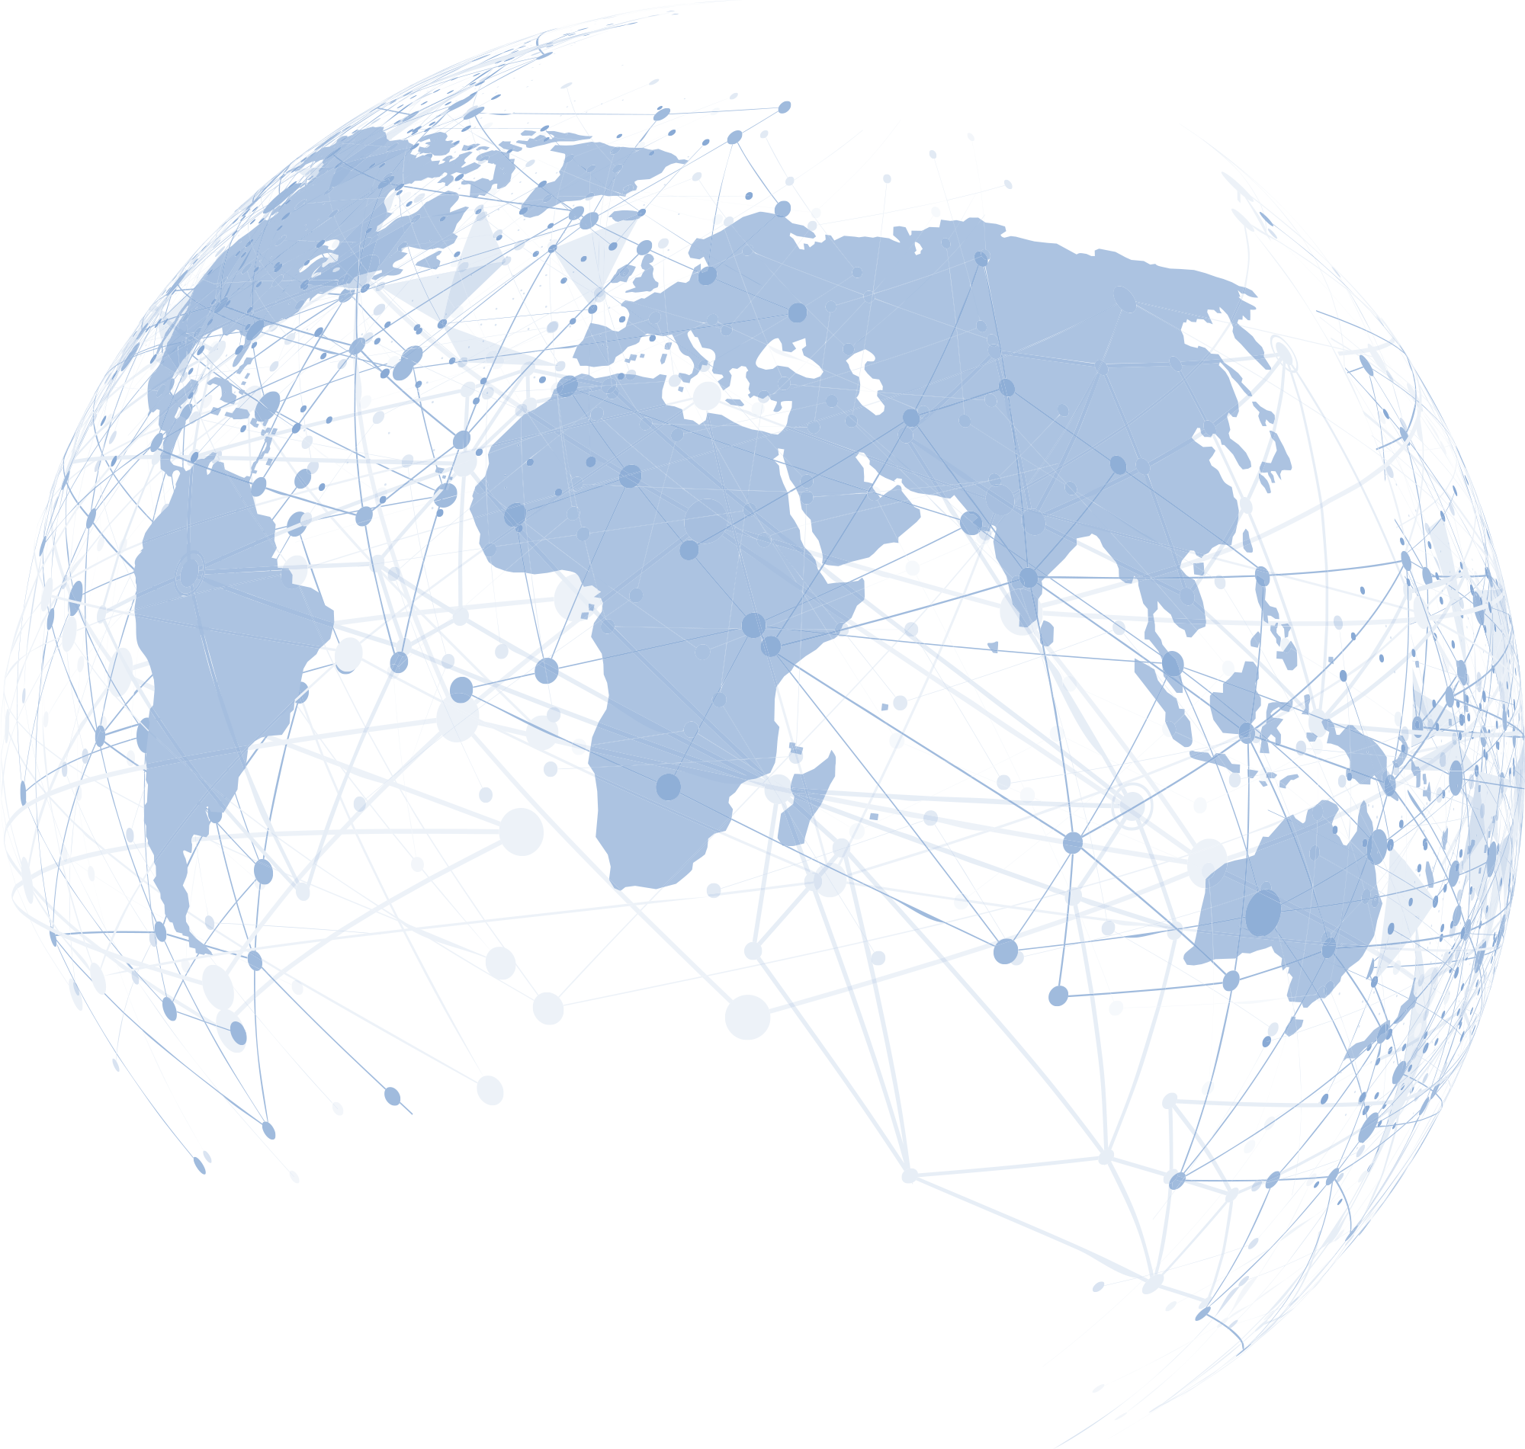
Joining Hands for a Pain Free Future Worldwide
WORLD DAY OF REGIONAL ANAESTHESIA & PAIN MEDICINE
3rd Edition
Equity, Access, Relief
Suggested discussion points
Top Papers in RA (2024-25)
Methodology check – Were these trials large, multicentre, and pragmatic enough to change practice, or are they single-centre signals?
Block choice – Do the findings favour new fascial plane blocks over classics (e.g., paravertebral, plexus blocks), and should we adopt them?
Opioid-sparing evidence – How convincing is the data that RA reduces opioid use and improves recovery beyond the first 24 hours?
Implementation – What barriers (training, ultrasound access, equipment costs) might prevent us from translating this evidence into everyday care?
Equity & sustainability – Do these papers consider LMIC contexts or environmental impact, and should that influence how we judge their importance
Top Papers in Pain Medicine (2024–25)
New drugs & adjuvants – Which pharmacological advances (e.g., novel neuropathic agents, ketamine/esketamine, biologics) look truly practice-changing?
Interventional techniques – Are new RCTs on procedures (e.g., nerve ablation, neuromodulation, targeted drug delivery) robust enough to support wider uptake?
Chronic pain models – How do the studies address the biopsychosocial model — do they balance physical, psychological, and social outcomes?
Opioid stewardship – What’s new in opioid-sparing or opioid-optimising strategies for chronic pain, and how do these align with WHO’s agenda for equitable access?
Patient-centred outcomes – Did the studies report outcomes that matter to patients (function, QoL, return to work), or mainly surrogate measures (pain scores, drug use)?

Slide 9
Joining Hands for a Pain Free Future Worldwide
WORLD DAY OF REGIONAL ANAESTHESIA & PAIN MEDICINE
3rd Edition
Equity, Access, Relief
NOTES

Slide 10
Joining Hands for a Pain Free Future Worldwide
WORLD DAY OF REGIONAL ANAESTHESIA & PAIN MEDICINE
3rd Edition
Equity, Access, Relief
NOTES

